Slide 1
Financial Statistics
Unit 7: Credit
Credit calculations review

Slide 2
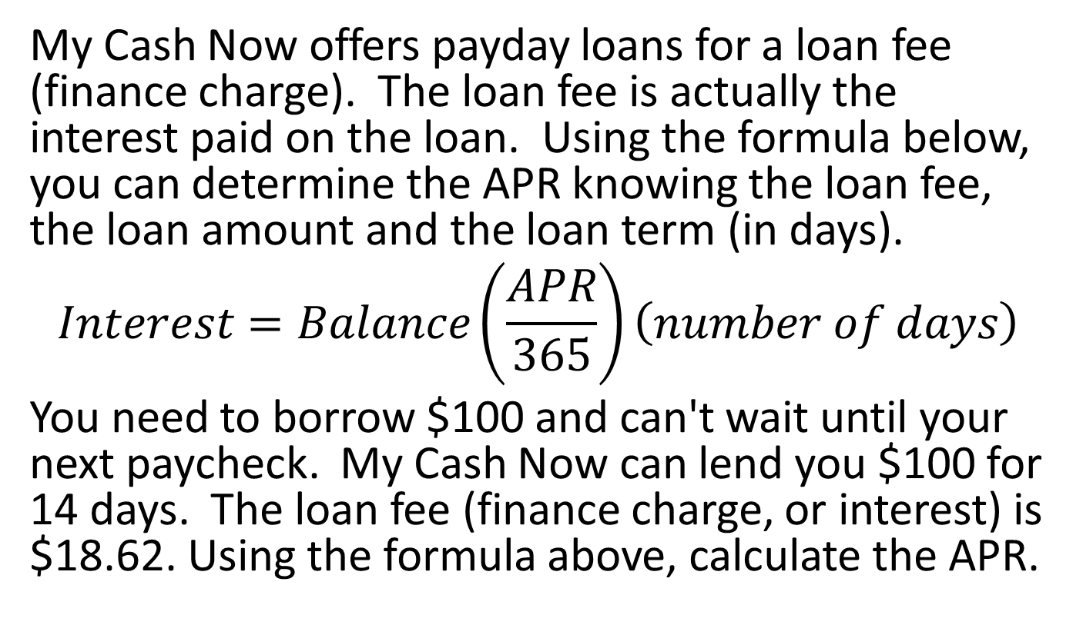
Problem 1
My Cash Now offers payday loans for a loan fee (finance charge). The loan fee is actually the interest paid on the loan. Using the formula below, you can determine the APR knowing the loan fee, the loan amount and the loan term (in days).
$$Interest=Balance\left(\frac{APR}{365}\right)\left(number of days\right)$$
You need to borrow $100 and can't wait until your next paycheck. My Cash Now can lend you $100 for 14 days. The loan fee (finance charge, or interest) is $18.62. Using the formula above, calculate the APR.
Notes:
485.45%

Slide 3
Problem 2
Monique purchases a $5,100 dining room set. She can’t afford to pay cash, so she uses the installment plan, which requires an 18% down payment. How much is the down payment?
Notes:
$918

Slide 4
Problem 3
Joe wants to purchase an electric keyboard. The price of the keyboard at Marcelli’s, with tax, is $2,344. He can save $150 per month. How long will it take him to save for the keyboard?
Notes:
15.63 ---> 16 months

Slide 5
Problem 4
Lisa purchases a professional racing bicycle that sells for $3,000, including tax. It requires a $200 down payment. The remainder, plus a finance charge, is paid back monthly over the next 2.5 years. The monthly payment is $111.75. What is the finance charge?
Notes:
$352.50

Slide 6
Problem 5
Snow-House sells a $1,980 snow thrower on the installment plan. The installment agreement includes a 20% down payment and 12 monthly payments of $161 each.
How much is the down payment?
What is the total amount of monthly payment?
What is the total cost of the snow thrower on the installment plan?
What is the finance charge?
Notes:
$396
$1,932
$2,328
$348

Slide 7
Problem 6
If the APR on a credit card is 22.2%, what is the monthly interest rate?
Notes:
1.85%

Slide 8
Problem 7
If the monthly interest rate on a credit card is 3%, what is the APR?
Notes:
APR = 36%

Slide 9
Problem 8
The average daily balance for Dave’s credit card statement was $1,213.44, and he had to pay a finance charge. The APR is 20.4%. What is the finance charge?
Notes:
$20.63

Slide 10
Problem 9
Mrs. Cykman’s credit card was stolen, and she did not realize for several days. The thief had charged a $10,000 watch, among other expensive items, while using it. How much is Mrs. Cykman responsible for paying?
Notes:
At most $50 because the thief purchased items before she reported it lost.

Slide 11
Problem 10
Mr. Kramden’s credit card was lost on a vacation. He immediately reported it missing. The person who found it days later used it and charged $2,000 worth of merchandise on the card. How much is Mr. Kramden responsible for paying?
Notes:
$0 because he reported it lost before the thief made purchases.

Slide 12
Problem 11
Pat’s ending balance on his debit card last month was $233.55. This month he had $542 worth of purchases and $710 worth of deposits. What is his ending balance for this month?
Notes:
$401.55

Slide 13
Problem 12
Tomika’s credit rating was lowered, and the credit card company raised her APR from 18% to 25.2%. If her average daily balance this month is $8,237, what is the increase in this month’s finance charge due to the higher APR?
Notes:
$49.42

Slide 14
Problem 13
If you lose your debit card and someone uses it to make purchases that add up to $1,487.29 before you report it lost, how much are you responsible for paying?
Notes:
$0 (you never owe anything on a lost/stolen debit card)

Slide 15
Problem 14
The summary portion of Manny’s credit card statement is shown. Determine the new balance.
Notes:
$2,607.79

Slide 16
Problem 15
Liz has a credit line of $9,000 on her credit card. Her statement summary is shown. What is her available credit?
Notes:
$6,688.11

Slide 17
Problem 16
Karen’s credit card statement summary is below.
What is her new balance?
If her average daily balance is $618.13, what is her APR?
Notes:
$1,145.57
57.6% APR

Slide 18
Problem 17
Sarah needs to borrow $18,000 to by a car. If her APR is 25% and the length of the loan is 5 years, what is her monthly payment?
$$M= \frac{P\left(\frac{r}{12}\right){\left(1+\frac{r}{12}\right)}^{12t}}{{\left(1+\frac{r}{12}\right)}^{12t}−1}$$
Notes:
$528.32

Slide 19
Problem 18
Steve is in credit card debt. His current credit card balance is $815.27. The APR on his card is 28.3%. If he makes the minimum payment of $25 each month and stops making new purchases on the card, how long will it take Steve to pay off his credit card?
$$N=\frac{1}{30}\frac{ln\left(1+\frac{B}{M}\left(1−{\left(1+\frac{r}{365}\right)}^{30}\right)\right)}{ln\left(1+\frac{r}{365}\right)}$$
Notes:
35 months (-34.15)

Slide 20
Problem 19
Sergio has a $5,218.92 balance on his credit card. He isn’t able to pay it in full right now, but he wants to pay it off in 2 years. If his APR is 19.6%, what monthly payment does Sergio need to make in order to pay off his card in 2 years?
$$M= \frac{P\left(\frac{r}{12}\right){\left(1+\frac{r}{12}\right)}^{12t}}{{\left(1+\frac{r}{12}\right)}^{12t}−1}$$
Notes:
$264.60

Slide 21
Problem 20
Mona graduated college with student loan debt of $10,000. The APR on his loan is 4%. If he pays $500 each month, how long will it take Mona to pay off her student loan?
Notes:
21 months (-20.72)

